Slide 1




Hyperion Update 27/03/2023
Shoaib Ajaib
@GliomaGenomics

Slide 2

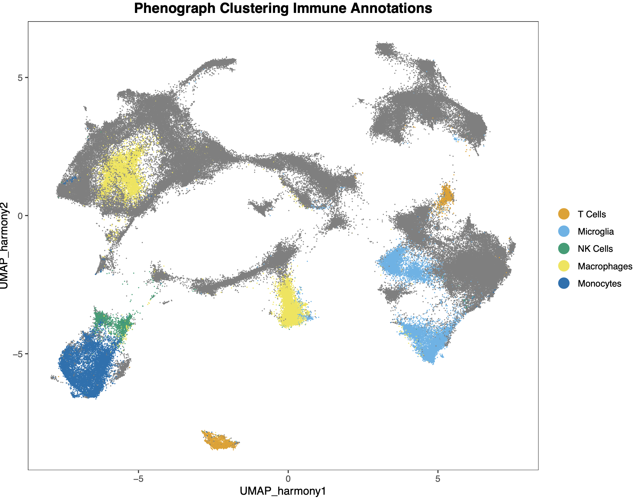
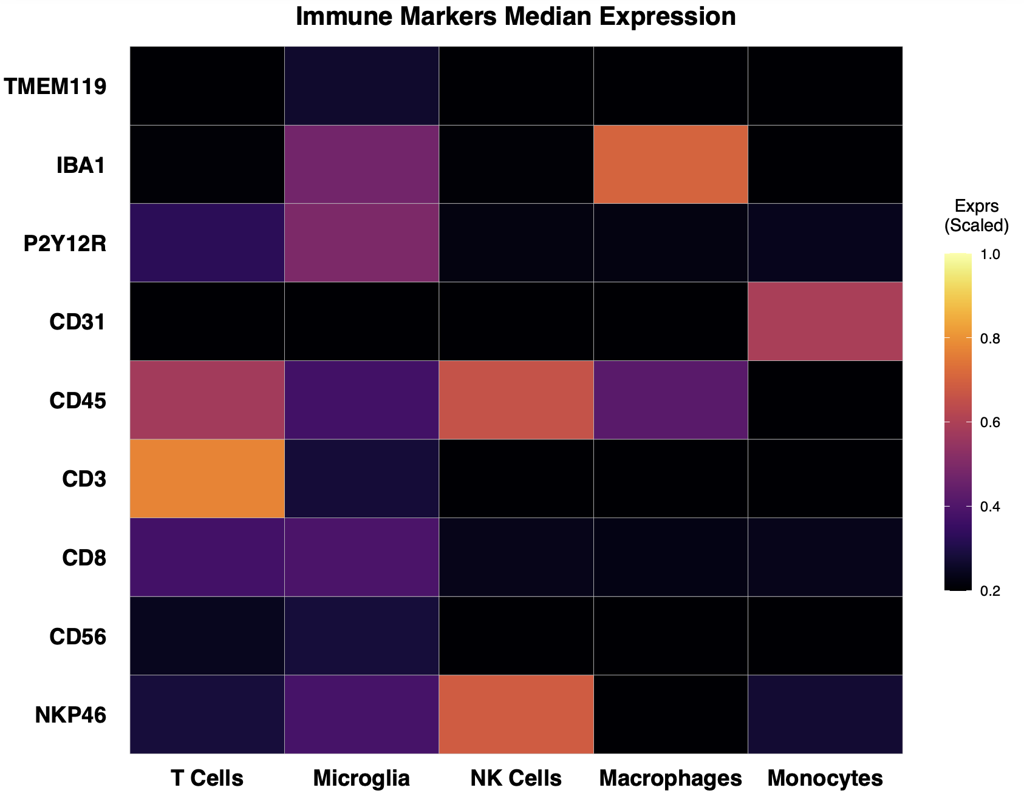
Labelling Scheme - Unsupervised Clustering

Slide 3
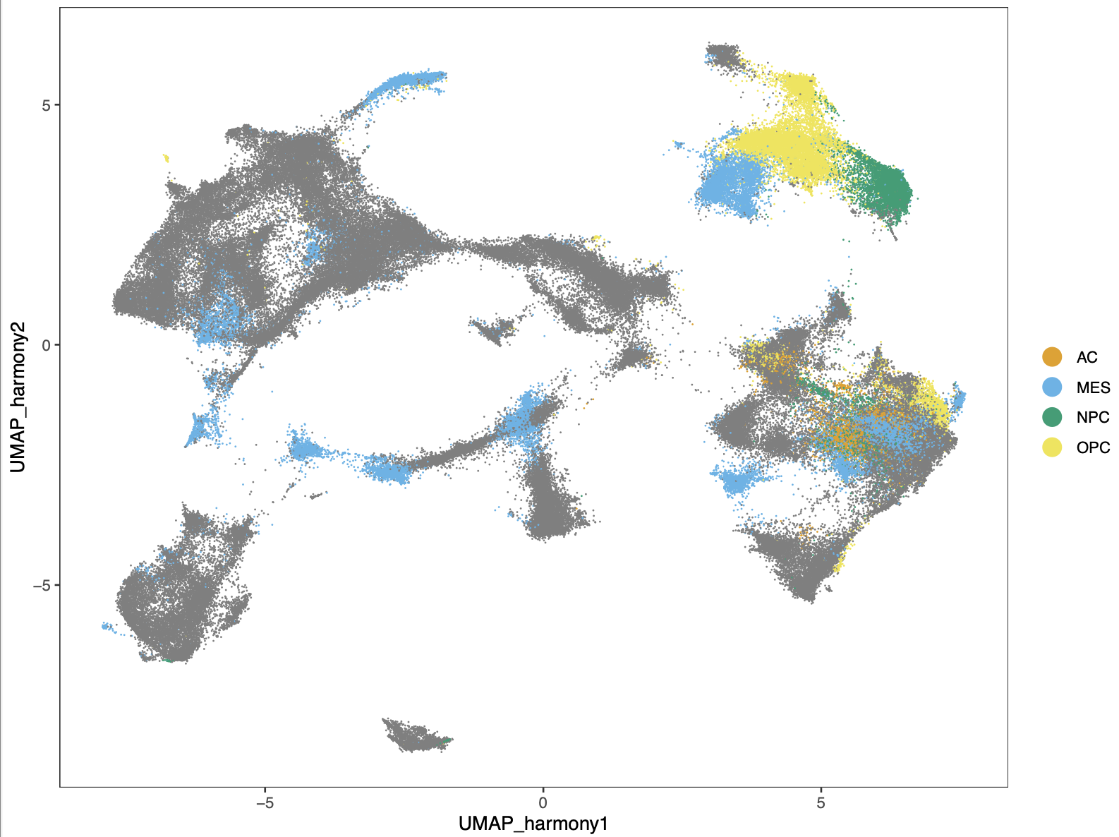
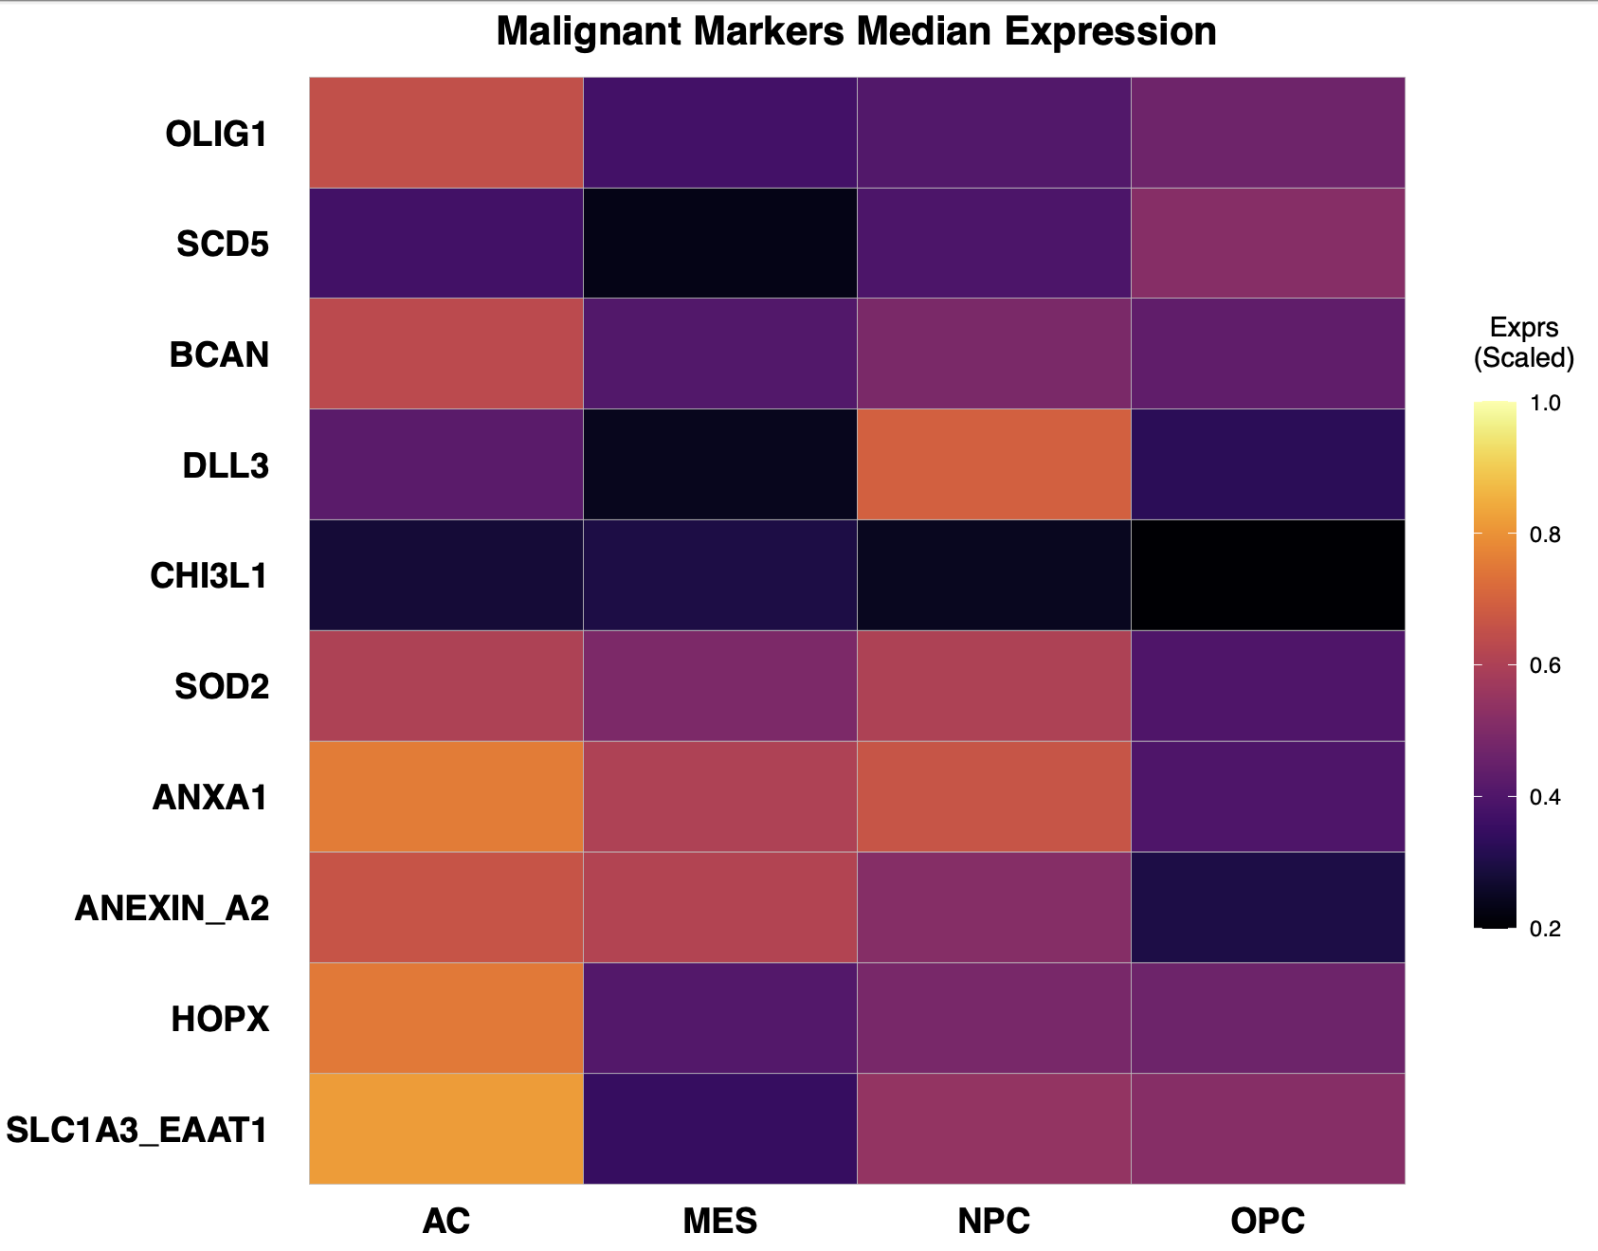
Labelling Scheme - Unsupervised Clustering

Slide 4
Labelling Scheme - Marker Expression Gating
Immune (CD45+)
Malignant (CD45 -)
All Cells
NK Cells (NKP46+)
T Cells (CD8+ OR CD3+)
Monocytes (CD31+)
Macrophages (IBA1+)
MES (SOD2+, CHI3L1+, ANXA2+, ANXA1)
NPC (DLL3+, BCAN+)
AC (SLC1A3_EAAT1+, HOPX+)
OPC (OLIG1+, SCD5+)
JARID2 Activating (JARID2_C+)
JARID2 Repressive (JARID2_N+)
Repressive (EZH2+)
Proliferative (SOX2+, KI67+)
Quiescence (TNC+, TGFBeta+)
Hypoxia (HIF1A+)
EMT (SNAI1+)
Microglia (TMEM119+, P2Y12R+)
Undefined Cells
Neuron (CD56+, NEUN_FOX3+)
Astrocyte (GFAP+)
Oligodendrocyte (MOG+)
Endothelial/Vasculature (SMA+, CD31+)

Slide 5
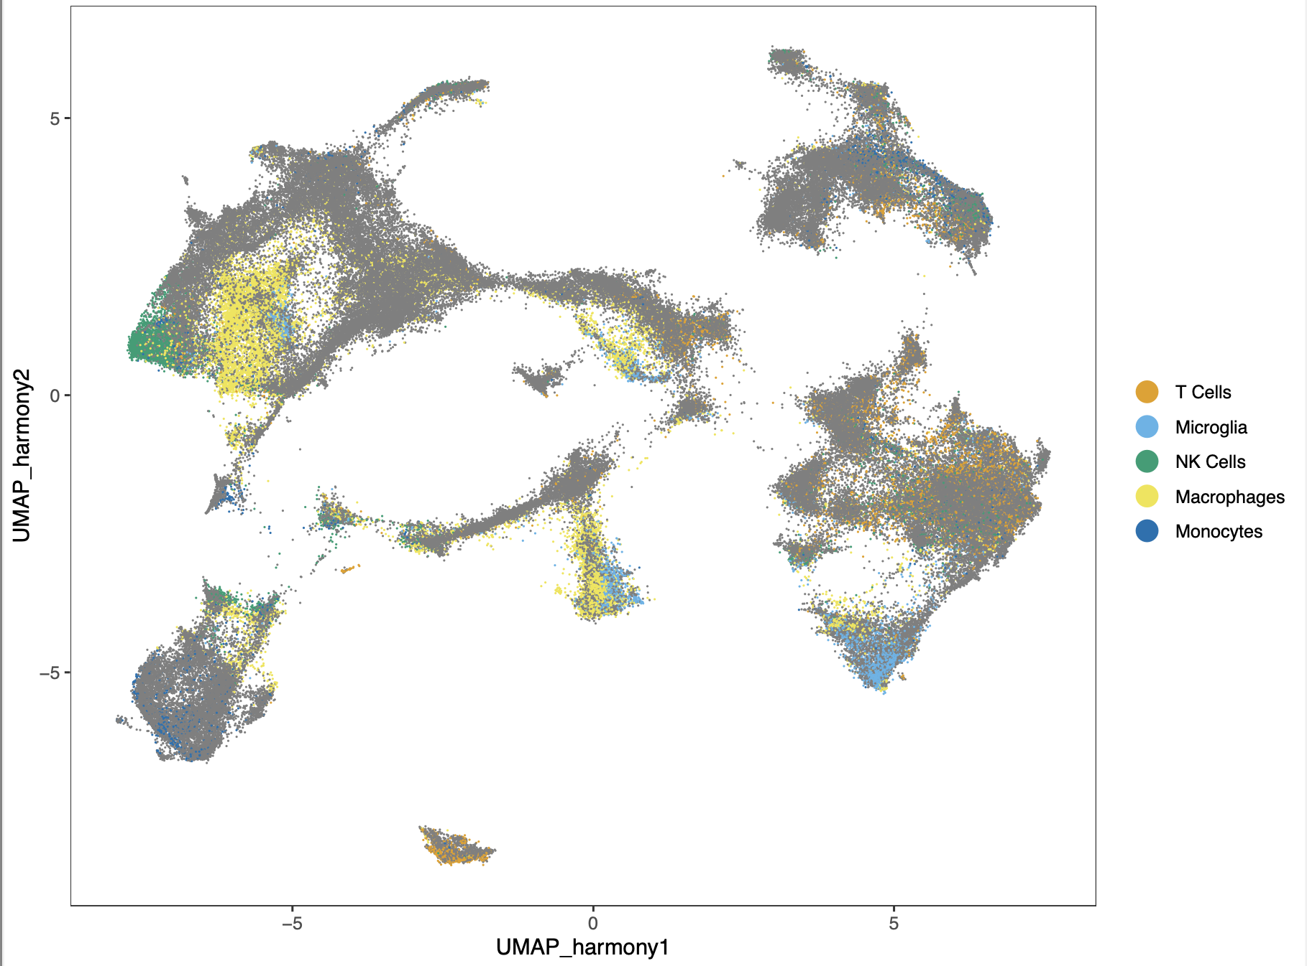
Labelling Scheme - Marker Expression Gating
Original
Revised

Slide 6
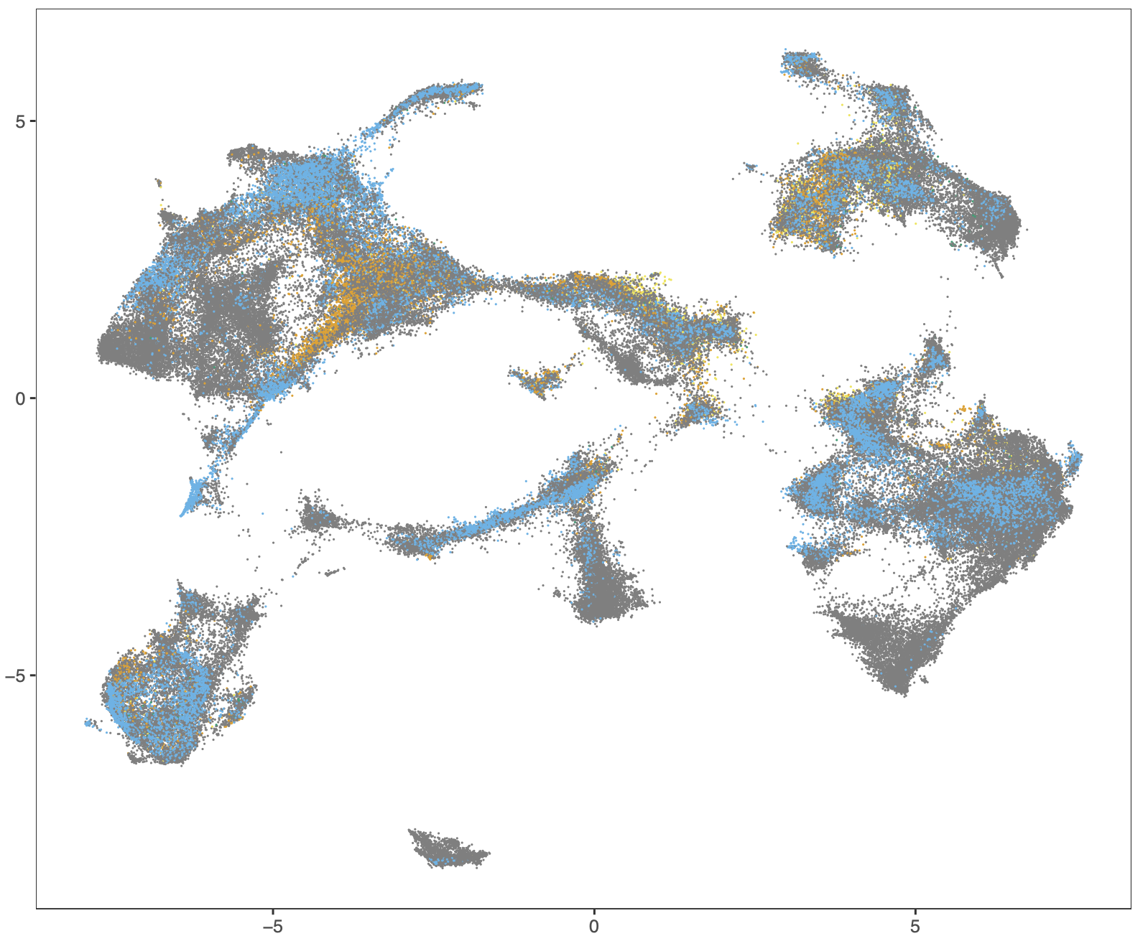
Labelling Scheme - Marker Expression Gating
Original
Revised

Slide 7
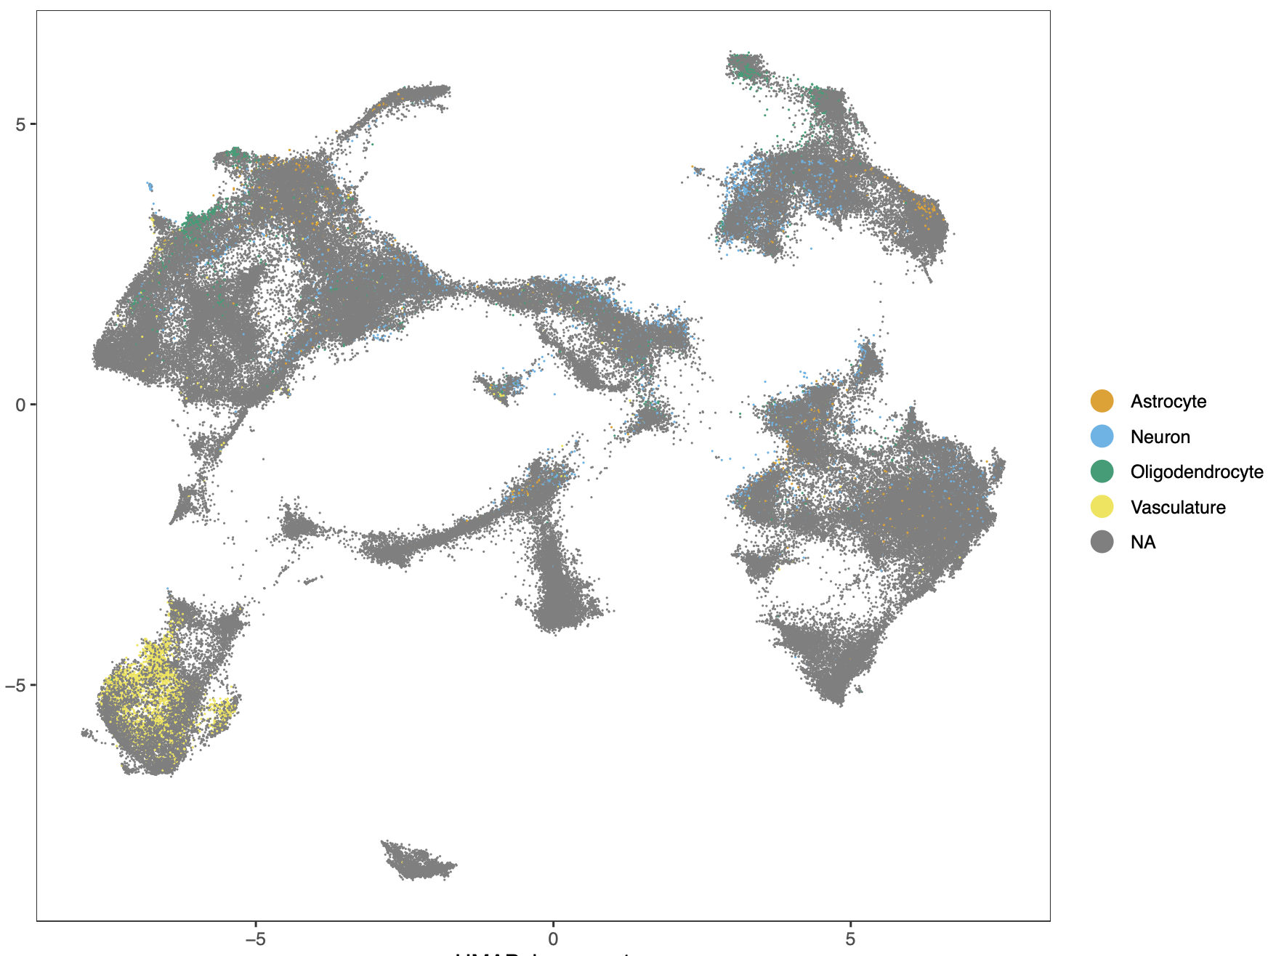
Labelling Scheme - Marker Expression Gating

Slide 8
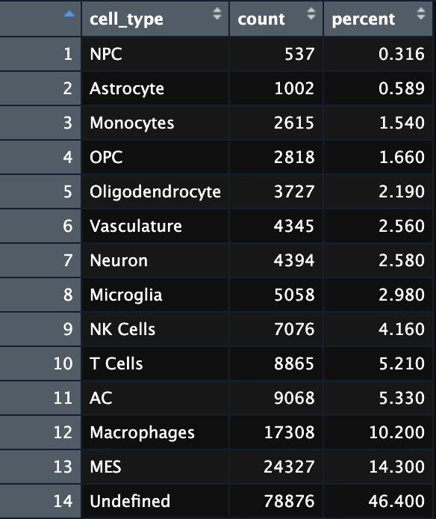
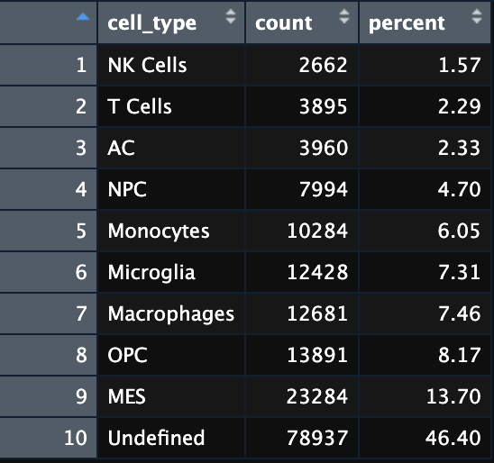
Labelling Counts/Coverage
Gating Expression
Clustering & MEM

Slide 9
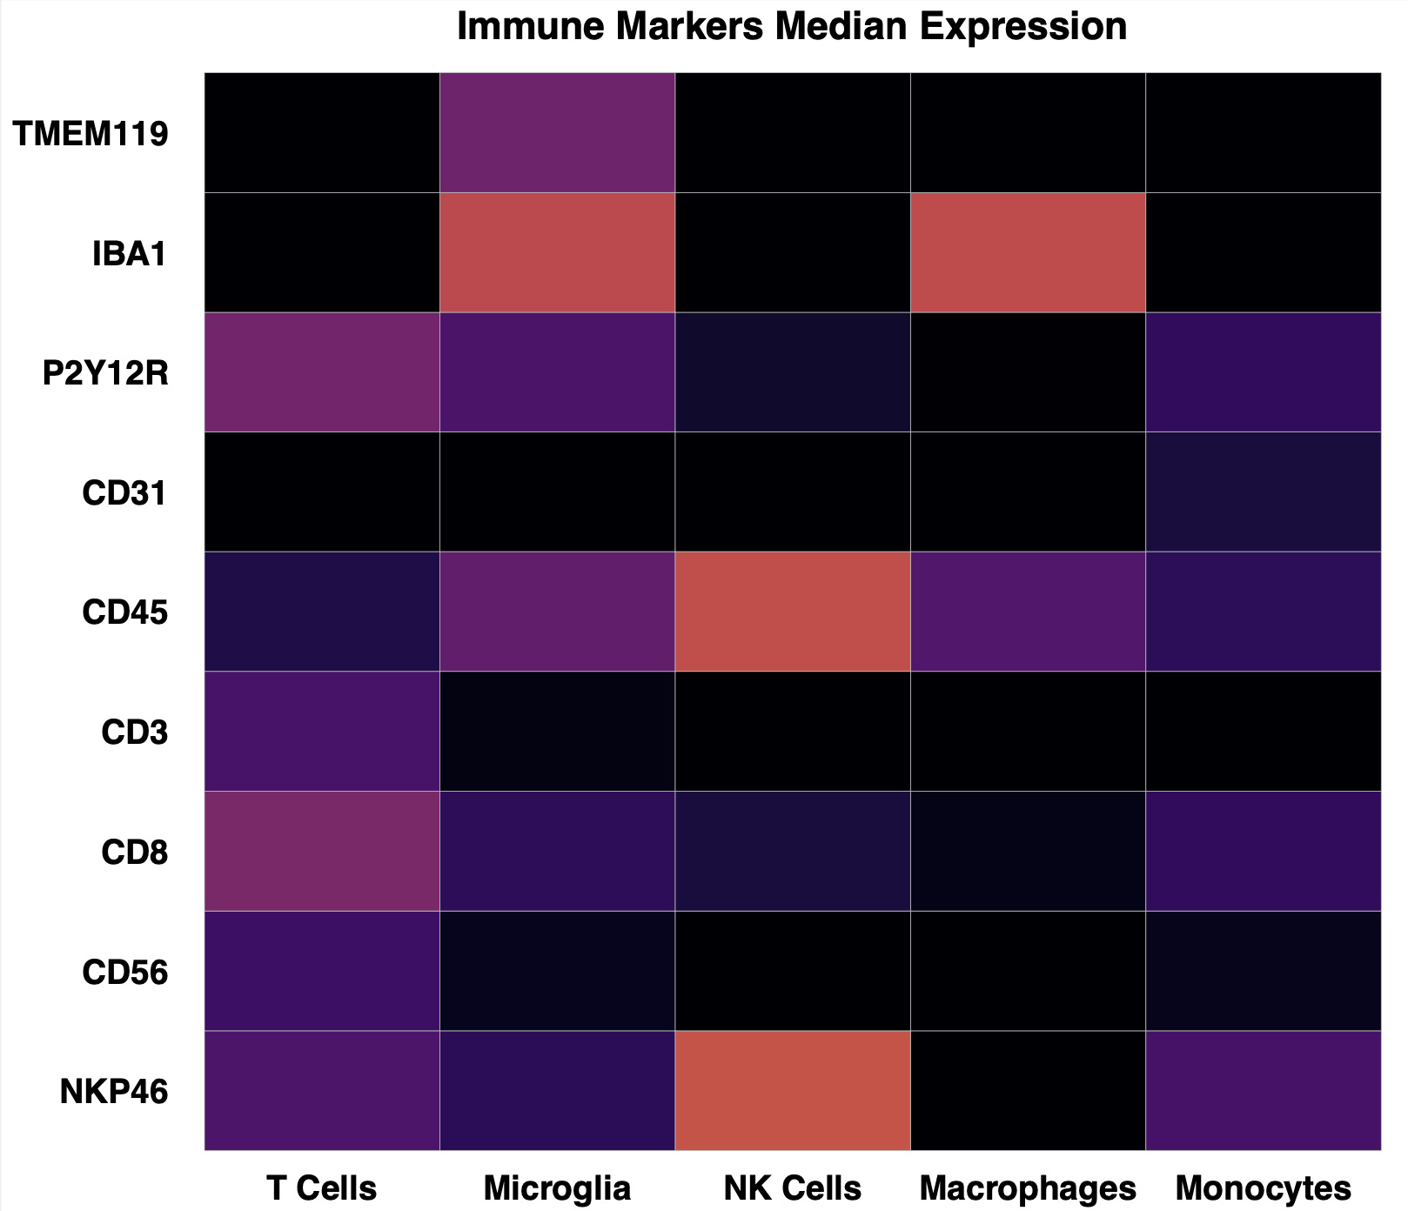
Labelling Scheme - Marker Expression Gating
Original
Revised

Slide 10
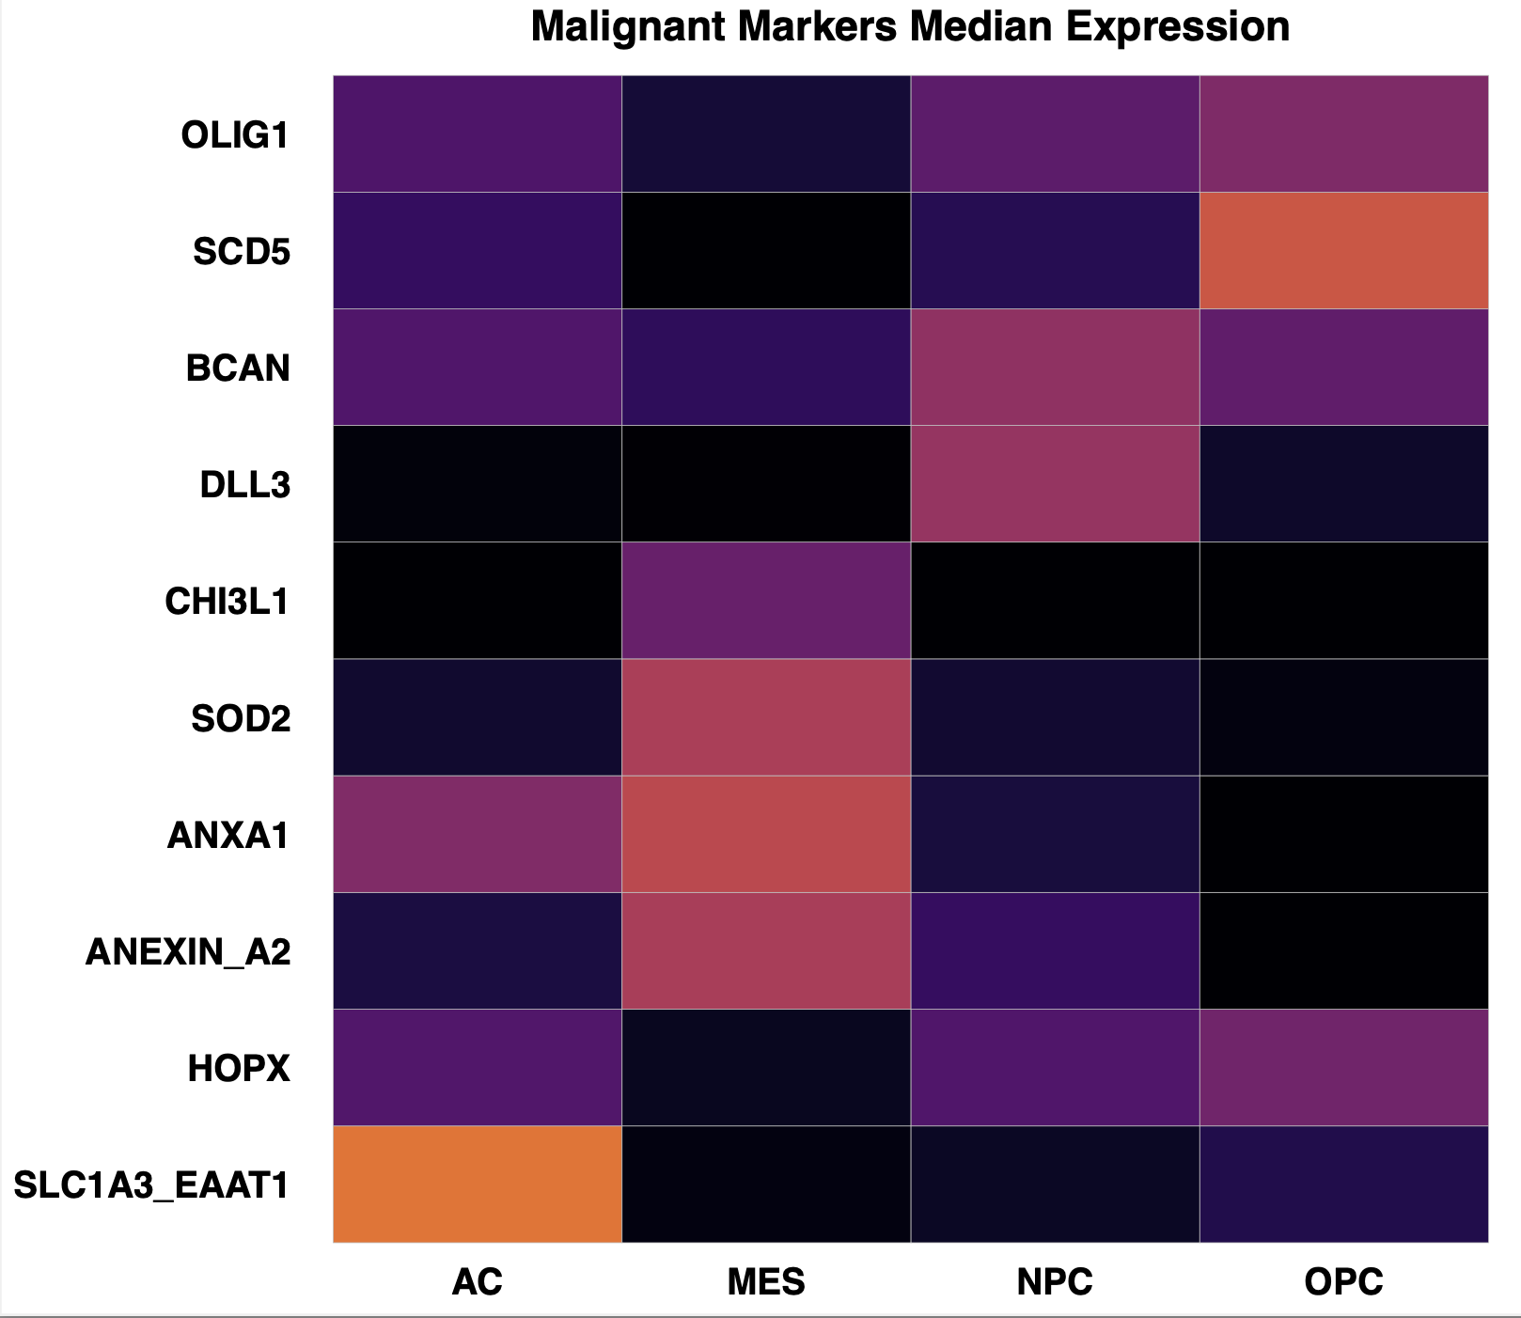
Labelling Scheme - Marker Expression Gating
Original
Revised

Slide 11
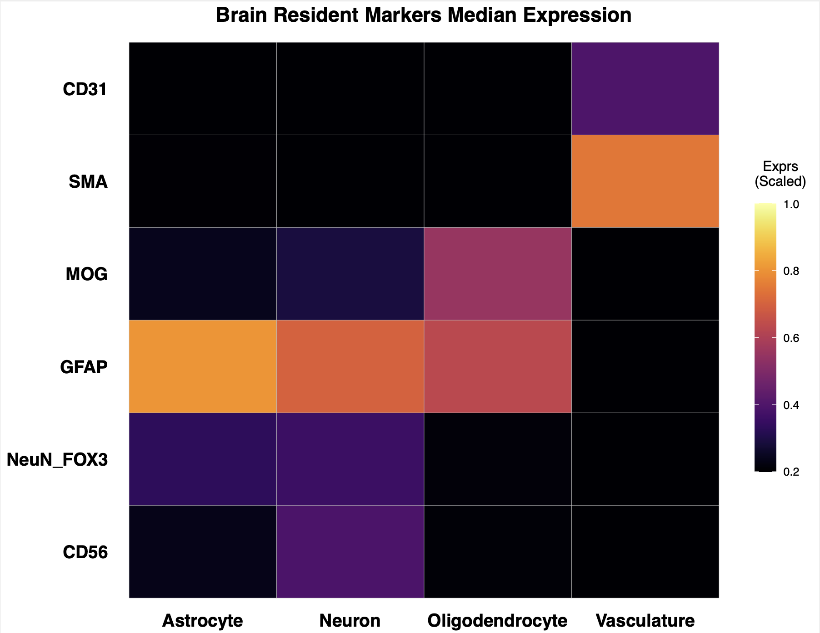
Labelling Scheme - Marker Expression Gating
Neuron (CD56+, NEUN_FOX3+)
Astrocyte (GFAP+)
Oligodendrocyte (MOG+)
Endothelial/Vasculature (SMA+, CD31+)

Slide 12
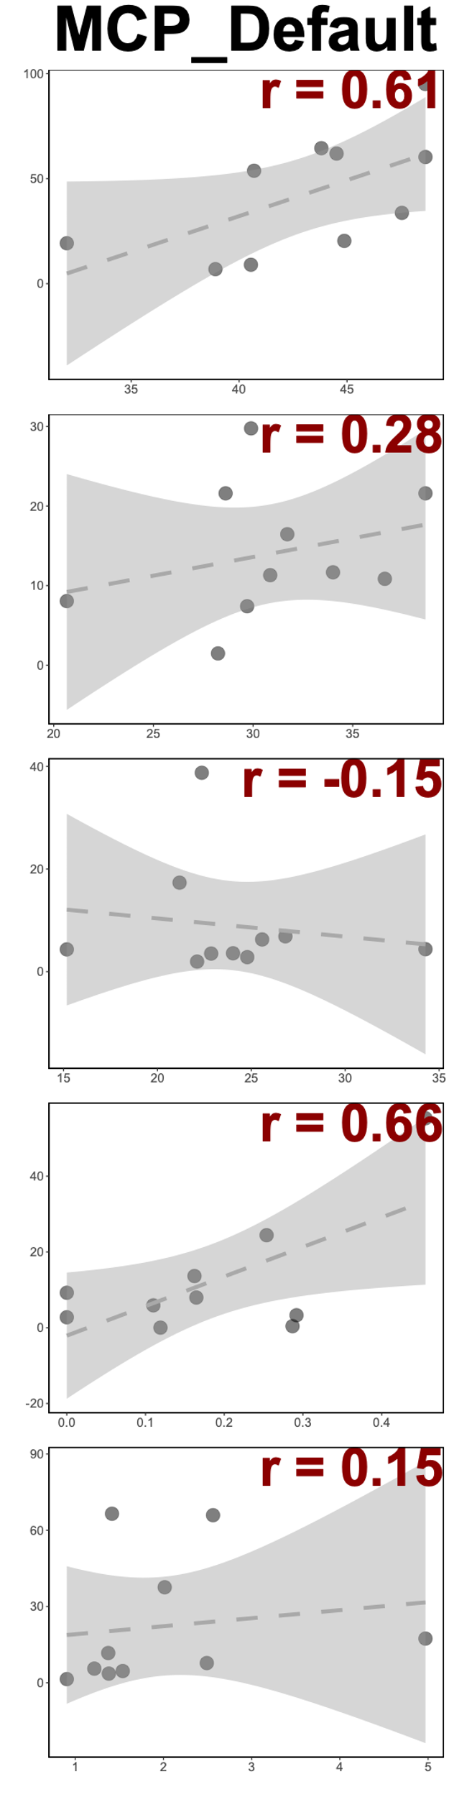
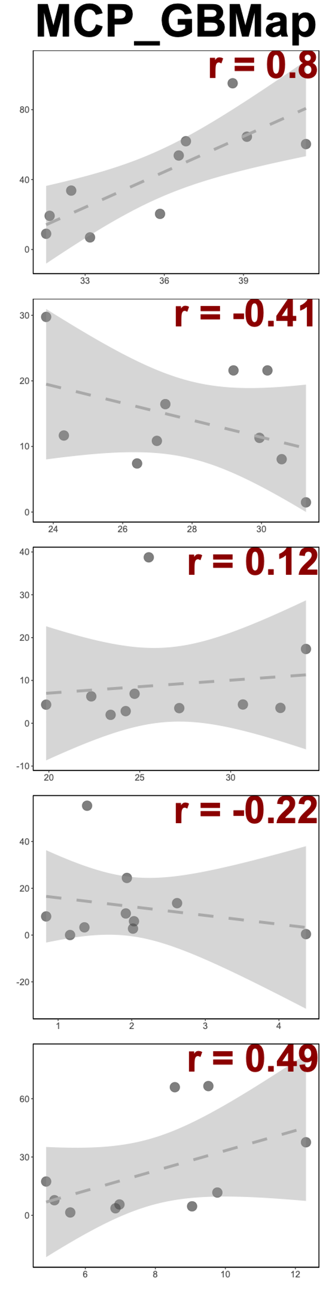
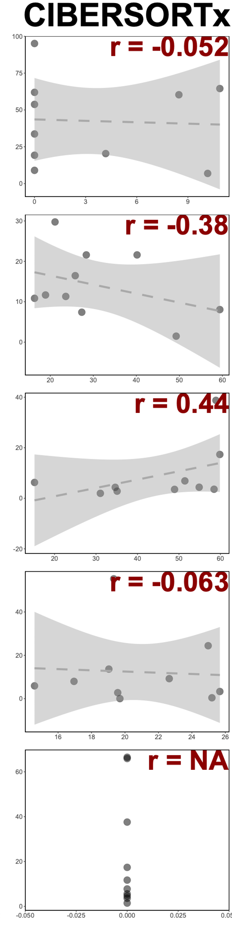
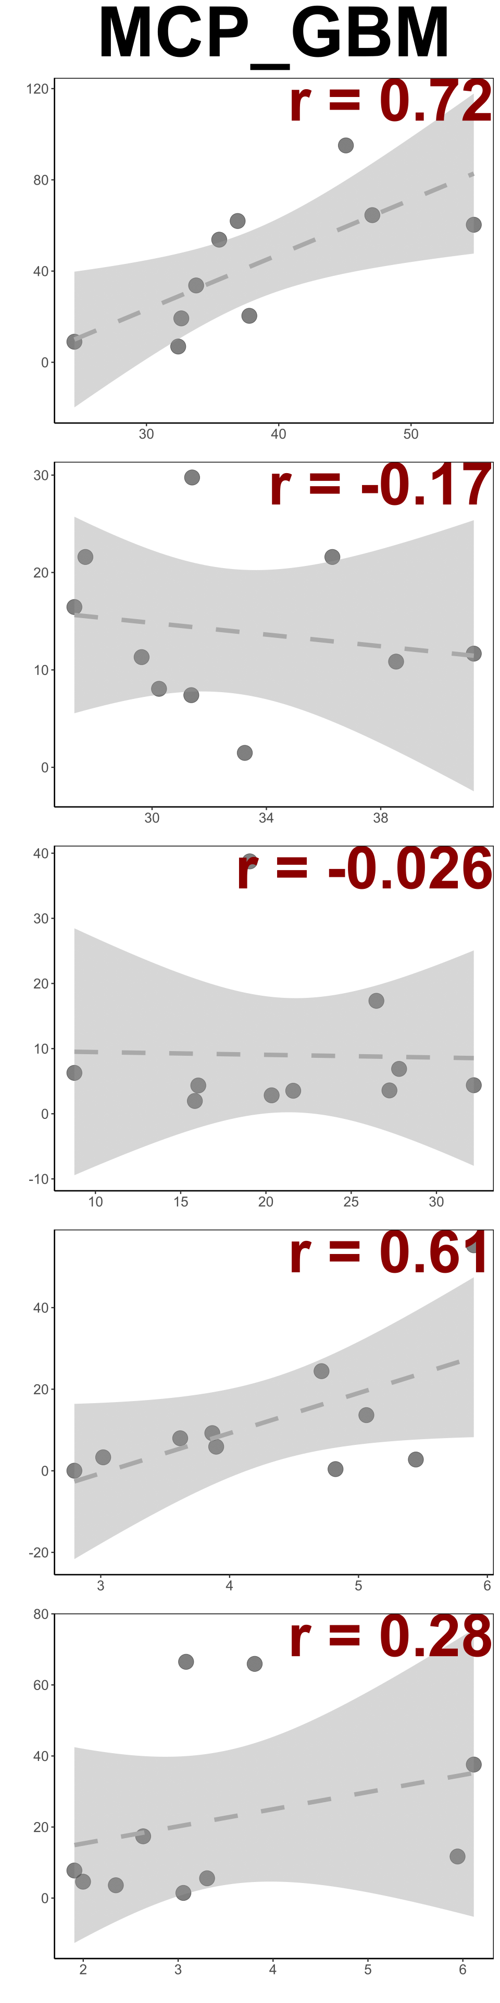
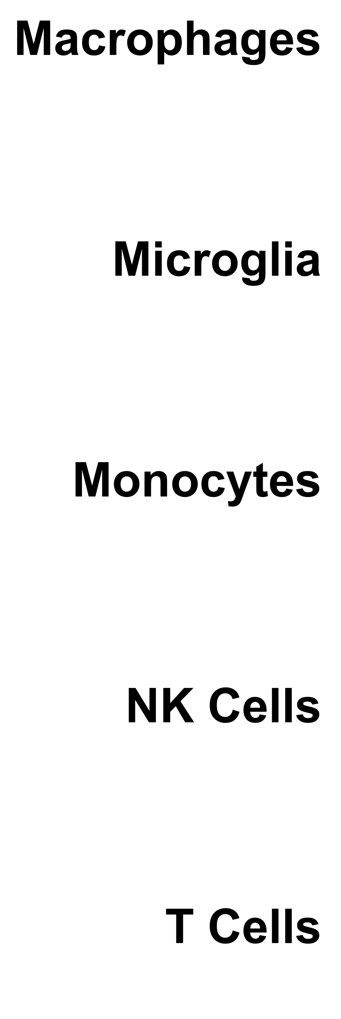
Manual Labelling Scheme – Deconvolution Correlation Comparisons
MCP_GBM

Slide 13
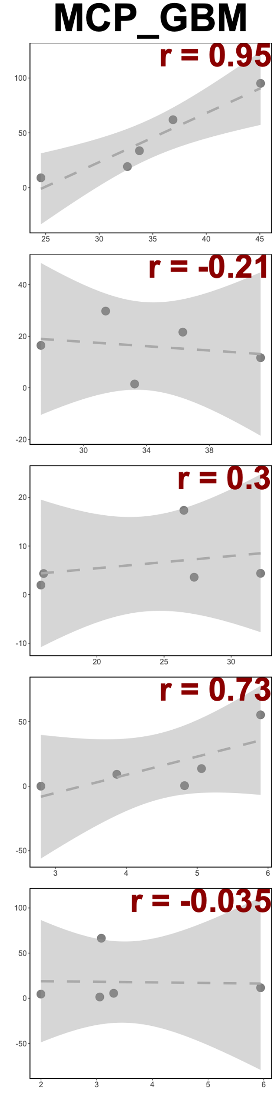
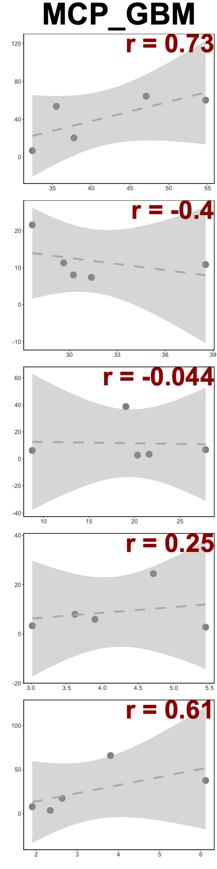
Manual Labelling Scheme – Deconvolution Correlation Comparisons
All
Primary
Recurrent
MCP_GBM
MCP_GBM
MCP_GBM

Slide 14
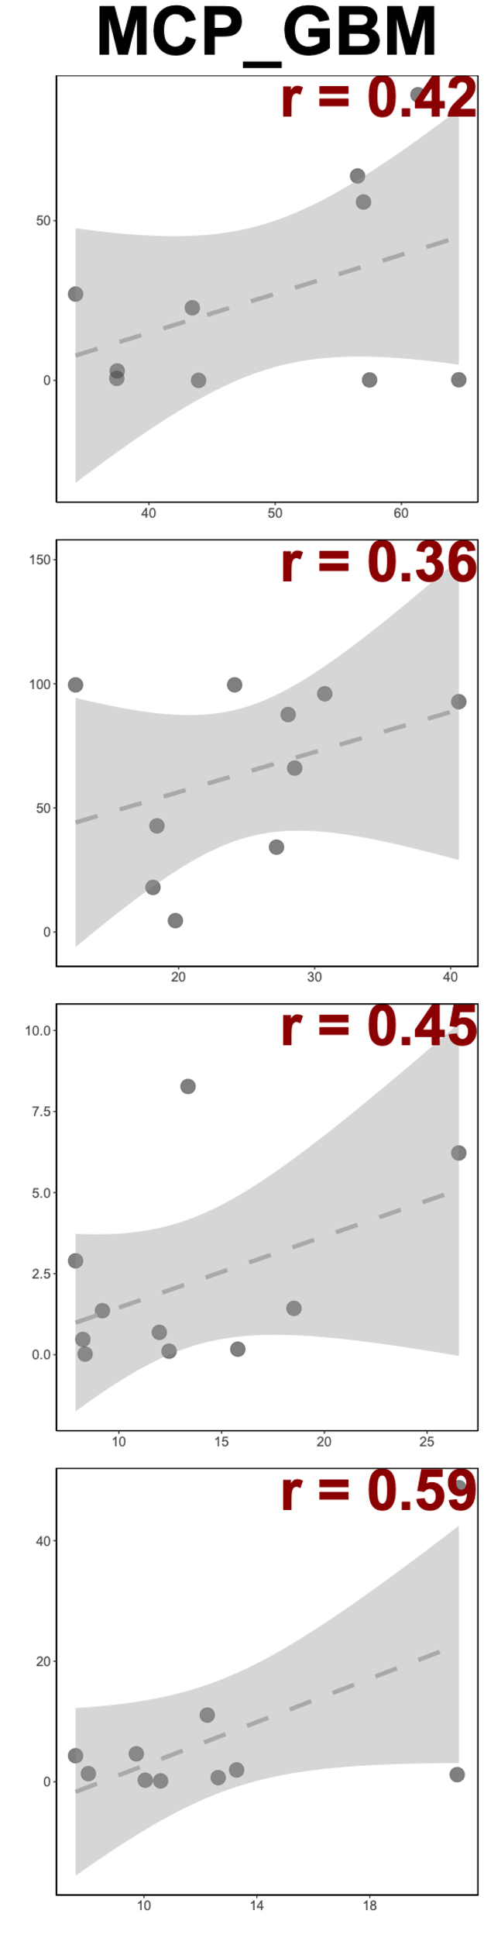
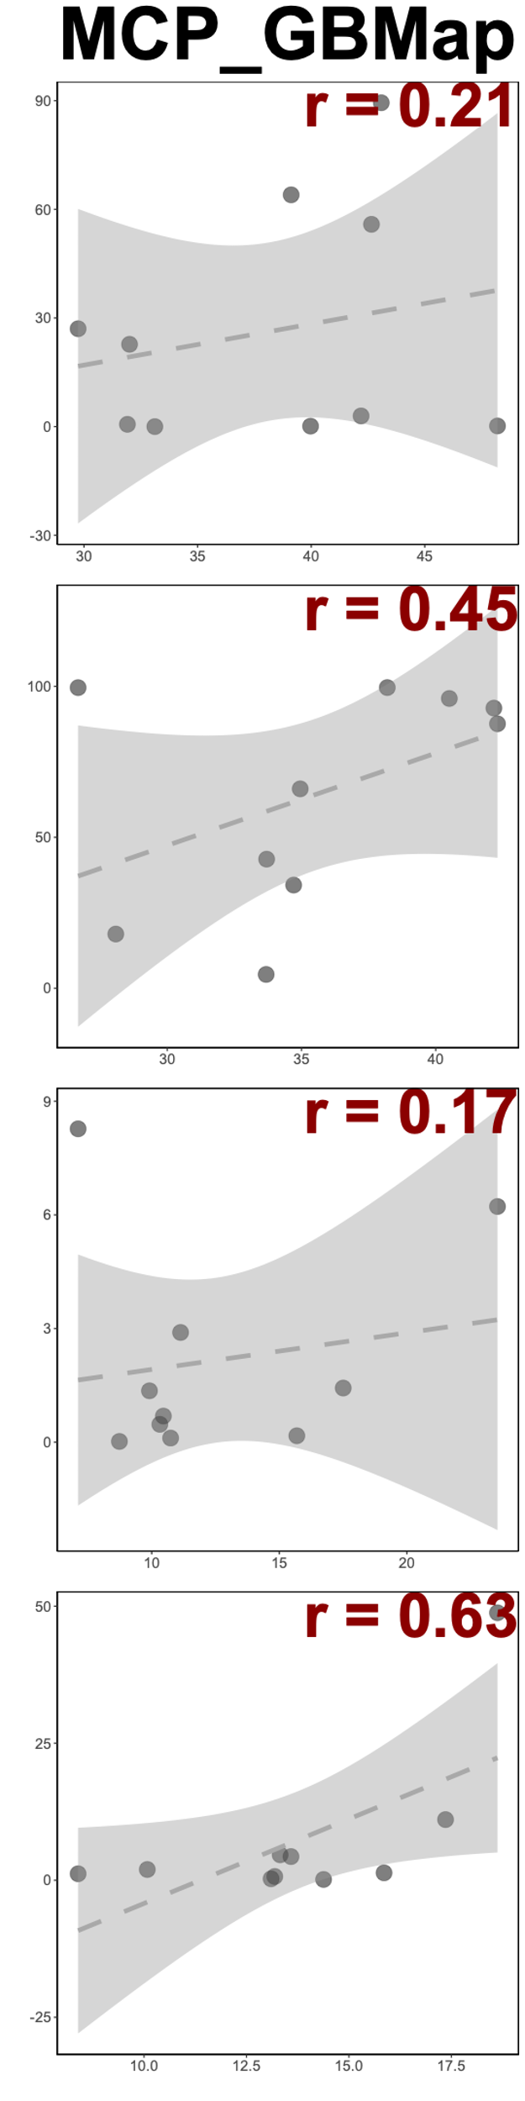
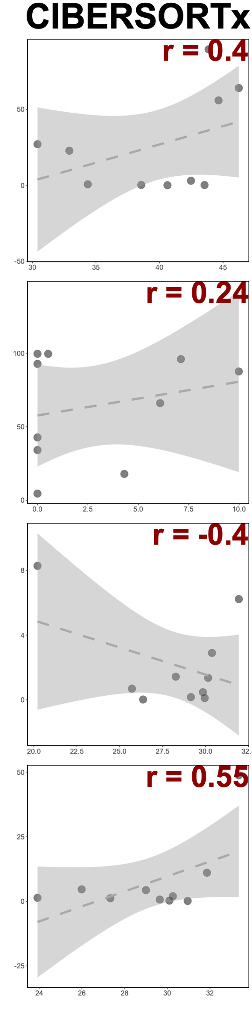
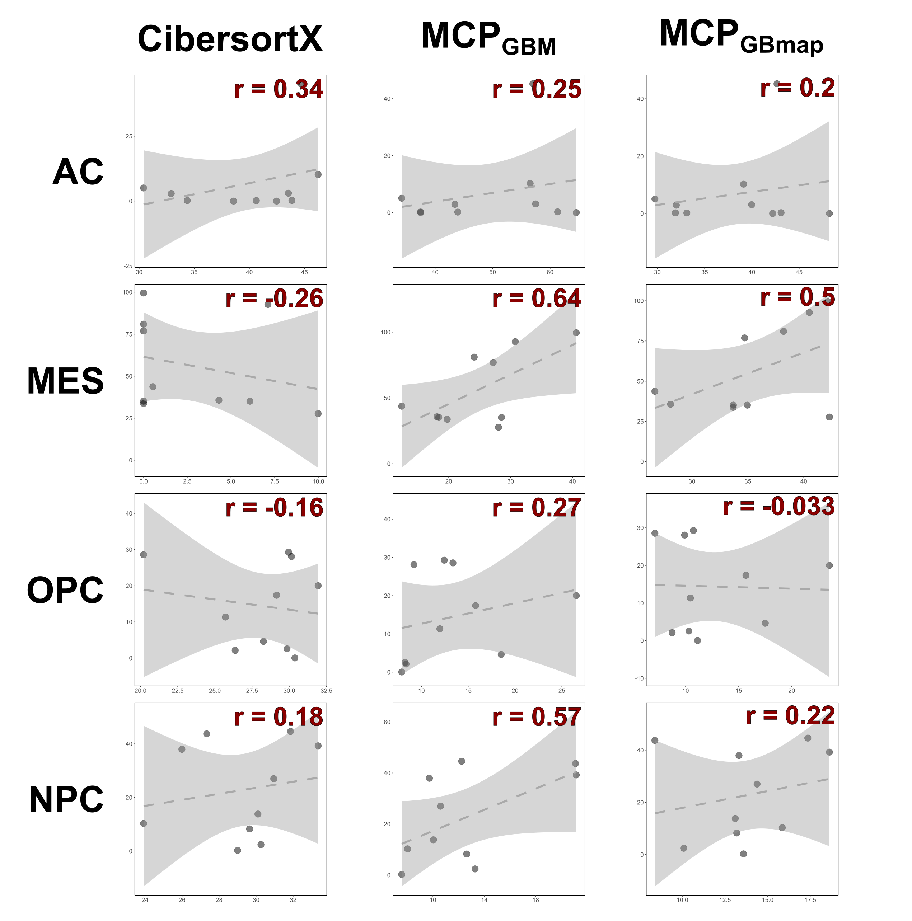
Manual Labelling Scheme – Deconvolution Correlation Comparisons

Slide 15
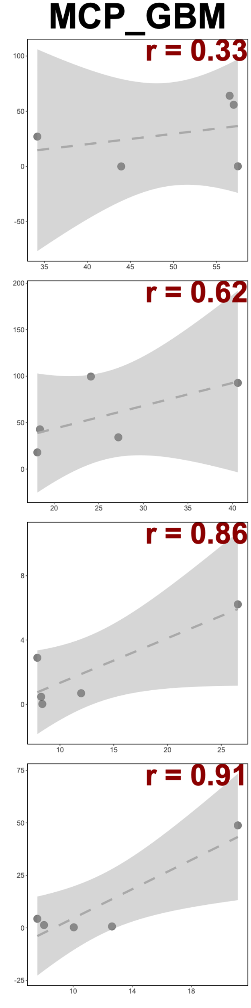
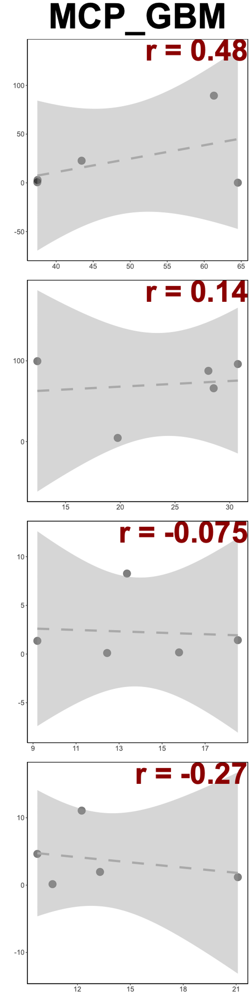
Manual Labelling Scheme – Deconvolution Correlation Comparisons
All
Primary
Recurrent

Slide 16
Hyperion Update 22/04/2023
Shoaib Ajaib
@GliomaGenomics

Slide 17
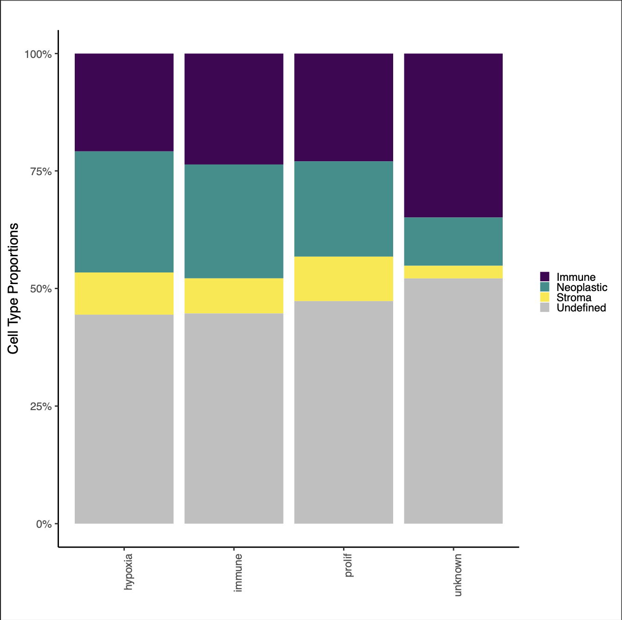
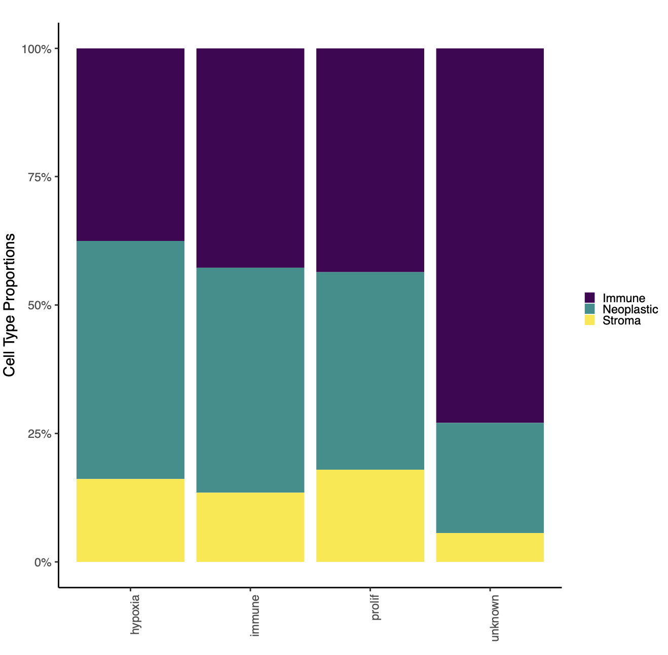
Cell Prevalence’s - Going to a lower resolution
cell_label | Prim | Rec | Prim_% | Rec_%
Immune | 32131 | 8791 | 29.726 | 14.196
Neoplastic | 21444 | 15306 | 19.839 | 24.717
Stroma | 6931 | 6537 | 6.412 | 10.556
Undefined | 47585 | 31291 | 44.023 | 50.53
cell_label | Prim | Rec | Prim_% | Rec_%
Immune | 32131 | 8791 | 53.104 | 28.697
Neoplastic | 21444 | 15306 | 35.441 | 49.964
Stroma | 6931 | 6537 | 11.455 | 21.339

Slide 18
Title

